Slide 1


Team 60: Solar Lighting System
Bi-Weekly Update 5 Josh George, Jeb Malek, Lyric Haylow Sponsor: Dr. Wonhyeok Jang TA: Rhett Guthrie
Notes:
Michelle

Slide 2

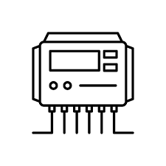



Solar Charging Overview Lyric Haylow
Solar Panels
Charge Controller
120Wh Battery
Moderates input charge from solar panels to battery
Reads battery percentage to Arduino for showing on Application
~21V
1.5A
Battery percentage read
Converter/ rest of system
MCU

Slide 3
Solar Charging Subsystem Lyric Haylow
Challenges
Max voltage accepted for Arduino is 5V
Initial board traces were incapable of handling current draw
Charge Controller isn't drawing sufficient current
Solutions
Created small circuit for stepping down voltage by factor of 0.175
Remade board with improved design for testing and handling current draw
Ordered Eval Board, have begun additional testing to check for faults

Slide 4
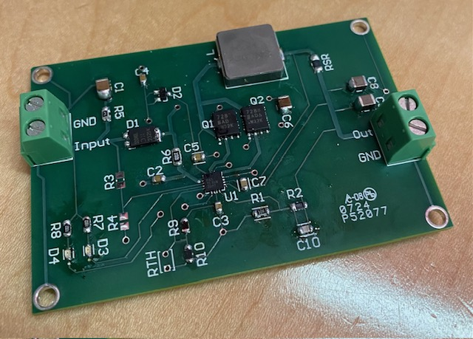
Solar Charging Results Lyric Haylow
Specification | Min | Nominal | Max
Solar Panel Input Voltage (V) | 5 | 21 | 25
Solar Panel Input Current (A) | 1 | 1.2 | 1.5
Charge Controller output current (A) | 0.5 | 2 | 10
Battery Voltage (V) | 2.1 | 12 | 26
Estimated Battery Life (hours) | 5.4 | 9 | 27
Item | Met
Controller recognizes both when to charge and when fully charged | Yes
Battery Voltage level sent to Microcontroller | Yes
Solar Panels give consistent current and expected Voltage | Yes
Controller actively charges Battery | No

Slide 5
Verifications
Solar panel outputs expected Voltage and Current.
Battery chosen both charges and discharges well, by test with working lighting system and test with solar panel.
Voltage values of the battery are actively sent to Bluetooth App, proven by checking values that app gets vs what battery is at.
Charge Controller designed recognizes batteries that need charge, as well as recognizes batteries that are fully charged
Charge Controller recognizes faulty systems attached in place of the battery.

